Slide 1
Catching a lion in a desert
THE SOFTWARE METHOD.
Make a linked list of all objects in the desert. Then delete the pointers on either side of the lion. (Make sure you are not AFTER the lion.)
Notes:
Course is based on DS. Overview. Connections with. Parts of Inf Theory, Inf Retrieval, etc. Other side – complex solutions involving multiple DS.

Slide 2
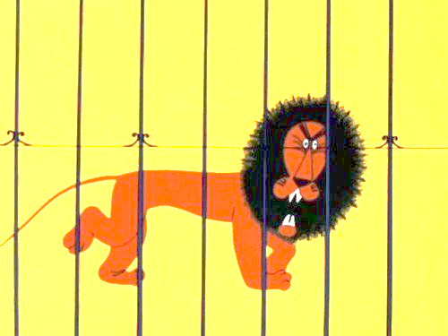
Mandatory reading
http://svoysredychuzih.livejournal.com/119943.html
http://www.gksoft.com/a/fun/catch-lion.html
http://www.columbia.edu/~sss31/rainbow/catch.lion.html
http://komplexify.com/epsilon/category/lion-hunting/
http://lurkmore.to/Как_поймать_льва_в_пустыне

Slide 3
Substring search
Программист на Паскале Просматривает пустыню полным перебором. Обнаружив льва, строит вокруг него клетку.
Notes:
Discrete math approaches

Slide 4
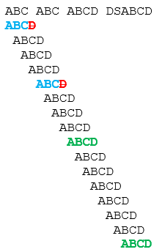
Naïve search
Notes:
Probability for uniform model: ~1/50 * ~1/50 = 1/2500. Second char even less.
BUT

Slide 5
Text examples
– Вы не видали еще? или: – вы не знакомы с ma tante [с моей тетушкой]? – говорила Анна Павловна приезжавшим гостям и весьма серьезно подводила их к маленькой старушке в высоких бантах, выплывшей из другой комнаты, как скоро стали приезжать гости, называла их по имени, медленно переводя глаза с гостя на ma tante [тетушку], и потом отходила.
Search for: гостя
-----------------------------------------------------
AAAAAAAAAAAAAAAAAAAAAAAAAAAAAAAAAAAAAAAAAAAAAAAAAAAAAAAAAAAAAAAAAAAAAABAAAAAAAAAAAAAAAAAAAAAAAAAAAAAAAAAAA
Search for: AAAAAAAAAAAAAAAAAAAAB
Notes:
E = n + epsilon
O = O(mn)

Slide 6
Notes:
AAAAAAAAAAAAAAAAAAAAB.
Matter of attack!!!! By simply running search queries (website, …)

Slide 7
Advanced search: skipping techniques
Knuth–Morris–Pratt (KMP)
The difference is that KMP makes use of previous match information that the straightforward algorithm does not.
When KMP sees a trial match fail on the 1000th character (i = 999) because String[x + 999] ≠ Pattern[999], it will know that the first 998 characters at the new position already match. So, in the beginning we create a table that will assist with calculating skip distance for O(m).
x ← x + i - T[i]
i ← T[i]
Also take a look on Boyer-Moore algorithm that skips even further.
 | 0 | 1 | 2 | 3 | 4 | 5 | 6
Pattern | A | B | C | D | A | B | D
Skip table T | -1 | 0 | 0 | 0 | 0 | 1 | 2
Notes:
O(n + m). N – length, M – substring.
Assume you have all different letters in the word – then you can easily skip all!
Otherwise – if string beginning repeat (skip until matching first symbol).

Slide 8
Advanced search: rolling hash
Rabin-Karp
Characters as numbers
Match hash codes of pattern and substring
Use rolling hash function
Notes:
What is hash function?
Can we compute hash in a constant time for any string?
Yes

Slide 9
Rolling hash: Rabin fingerprint
hash(“bcdefg”) = f(hash(“abcdef”), “a”, “g”)
hash("abr") =
(97 × 101²) + (98 × 101¹) + (114 × 101⁰) = 999,509
hash("brc") =
[101 × (999,509 - (97 × 101²))] + (99 × 101⁰) = 1,011,311
removed “a”
added “c”
Notes:
Rolling hash: initial hash, what is added and what is removed

Slide 10
Notes:
Bad – королевы, полёвки и прочее.

Slide 11
Indexing
Программист на Си++ Проектирует клетку таким образом, чтобы лев был ее составной частью. При инициализации клетки лев автоматически генерируется внутри
Professors of mathematics will prove the existence of at least one lion and then leave the detection and capture of an actual lion as an exercise for their graduate students
Notes:
Indexing creating shortcuts,
some dictionary where we can ask questions without necessarily accessing the text.

Slide 12
Techniques used across methods
case folding: London = london; Лев = лев
stemming: compress = compression = compressed лев = льва = львом
ignore stop words: to, the, it, be, or, ...
Problems arise when search on “To be or not to be” or “the month of May”
Thesaurus: fast = rapid; лев = лёвушка
handbuilt clustering
Notes:
The idea is to reduce lexicon w/out significant loss of generality.
Stemming – searching for stems (корень)

Slide 13
Indexing
Tokenization
Stream
Regex
Indexing
Inverted file indexing
Signature files
Vector space models

Slide 14
Tokenization
Statisticians
hunt the first animal they see N times and call it a lion

Slide 15
Tokenization: stream
Lexemes (distinct objects of the language) are produced by scanner.
token = (lexeme, token_type)
Program, converting stream of characters into a stream of tokens is called lexical analyzer, lexer, tokenizer.
E.g. for Java:
T1 = (“Lion123”, “identifier”)
T2 = (“+”, “binary operator”)
T3 = (“++”, “unary operator”)

Slide 16
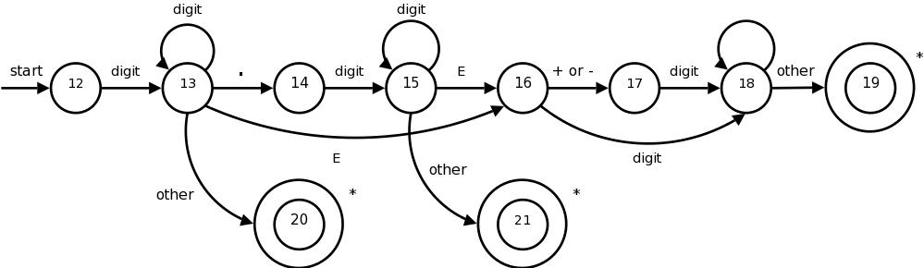
Stream tokenization
Uses finite-state machine (FSM), where states are token types.
It can be coded as a giant “switch” operator or as a transition table (as FSM it is a digraph!).
Example of number parsing:

Slide 17
Regex tokenization
Regular expressions – specific query language for pattern matching within a string. Patterns can use sophisticated wildcard and rules.
This language is pretty complicated.
Has 2 major implementations:
NFA – non-deterministic finite-state automata. Use greedy backtracking thus the (a) can find all possible matches (b) can be sometimes too slow (Perl, .NET)
DFA – deterministic finite-state automata. Linear in time, but lack some features
For the proposed task I suggested:
[\s\.\,\-]*([a-яА-Яa-zA-Z0-9]+)[\s\:\.\,\-!\')]+
Notes:
Subqueries, reverse links ,,….
ALSO NOT SREAM

Slide 18

Tokenization stability
Text file | Size (B) | Stream (ms) | Regex (ms)
ViM-book1.txt | 2 616 453 | 526.83 | 829.79
ViM-book2.txt | 2 712 103 | 627.14 | 906.13
x-synthetic.txt | 876 980 | 150.17 | Not finished in 5 minutes

Slide 19
Creating index
Программист на Делфи Пишет во все конференции: "Народ, где взять компонент, который ищет в пустыне льва и помещает его в клетку?"

Slide 20
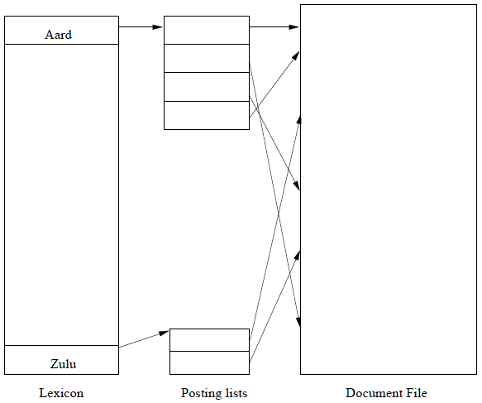
Inverted file index
Lexicon – all words
Posting list – references
-------------------------------------------
The geometrical inversion method
We place a spherical cage in the desert, enter it and lock it from inside. We then perform an inversion with respect to the cage. Then the lion is inside the cage, and we are outside.

Slide 21

So what?
Deserialized in 33.86 ms
1-word search in 0.00 ms
2-word search in 1.84 ms
3-word search in 0.18 ms
Notes:
Complex queries are made with Set intersection

Slide 22

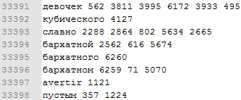
Granularity of Index
The granularity of the index refers to the resolution to which term locations are recorded within each document. This might be at the document level, at the sentence/line level or exact locations.
For proximity searches, the index must know exact (or near exact) locations.
In this case index size is a sufficient fraction of initial file.
Notes:
Speak about coding overhead

Slide 23
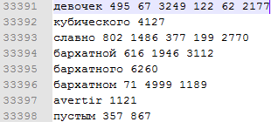

Index compression
Line numbers/positions in a file have very high entropy. How can we reduce entropy? Let’s store deltas!
sort(s)
delta[i] = s[i] – s[i-1]
… and then compress with some lossless compression algorithms (arithmetic coding, Huffman coding).
Notes:
We do the same in CD-DA / WAV files.
Consider overheads and num/string storing.
PPMd which uses stats to guess next symbol, and them coding.

Slide 24
Coding
Code – mapping of the dictionaries/alphabets.
ASCII (a = 97), Unicode (ß = U+00DF)
transliteration (я = ya), …
Morse (a = “● ─ “)
Prefix code – none of the code symbols are prefix for the other code.
A = 0001, B=00010

Slide 25
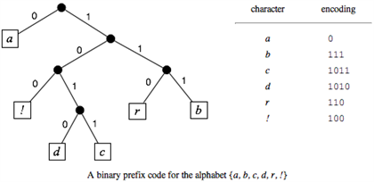
Compression coding
Compression is based on the method that more frequent symbols are encoded with shorter codes.
Thus, code is variable-length. How we determine symbol borders? Using prefix properties!
Notes:
Now we have to build the tree

Slide 26
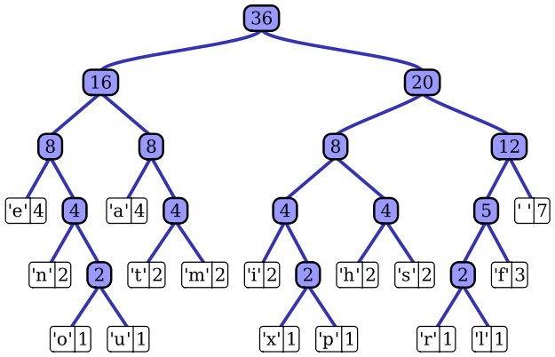
Huffman coding
Idea:
Construct binary tree where symbols are leaves.
Left branch is 0, right branch is 1. Path from root to leaf – code.
Longer the path – smaller the frequency.
Bottom-up approach:
Take 2 least probable symbols, create parent node for them and assign sum of probabilities to it. Return new node to collection. Repeat until you get a tree.
See also Shannon-Fano for top-down method
Notes:
COOL_COMPRESSION
O=4
C=2
S=2
_ L M P R E I N = 1
O C S _L MP RE IN
O _LMP REIN C S
O _LMP REIN CS
O_LMP REINCS
Join

Slide 27
Signature files
General idea of signature for a file is to create small enough set representing word occurrence. Howto:
Construct fixed length long-enough hash function for a token
…
Bloom filter!
No Lexicon!
For 32KB signature (for any! text) with 33000 expected vocabulary:
P(false+) = 0.6185^(8* 32K / 33K) ~ 0.6185^8 = 0.021
--------------------------------------------------------------------------------------------------------------
The thermodynamics method
We construct a semi-permeable membrane which lets everything but lions pass through. This we drag across the desert.
Notes:
33000 – with flexions in all forms. Tolstoy (other big texts – 18000).

Slide 28
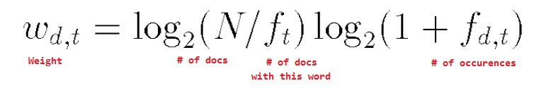
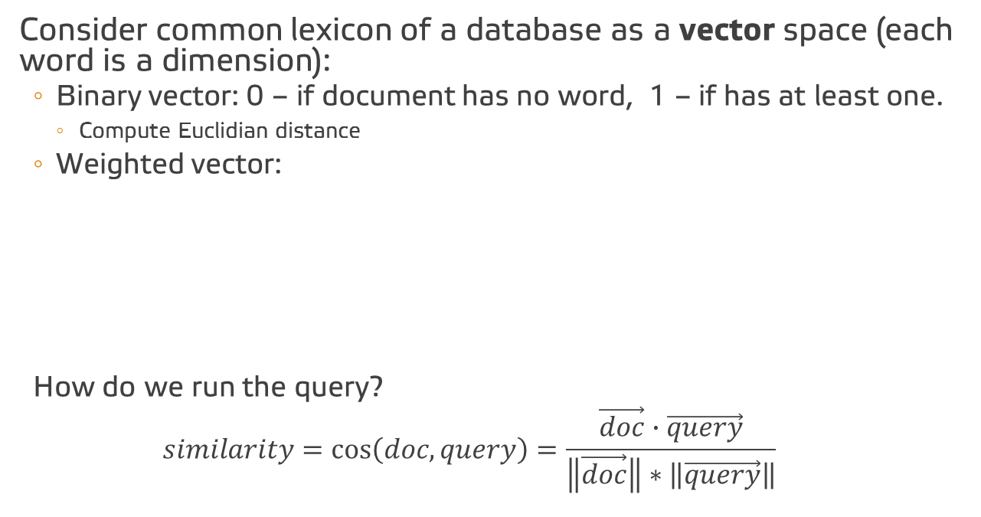
Vector space model
Consider common lexicon of a database as a vector space (each word is a dimension):
Binary vector: 0 – if document has no word, 1 – if has at least one.
Compute Euclidian distance
Weighted vector:
How do we run the query?
$$similarity=cos\left(doc, query\right)=\frac{\vec{doc}∙\vec{query}}{\left\|\vec{doc}\right\|∗\left\|\vec{query}\right\|}$$
Notes:
First multiplier normalizes the weight of the word in dataset, second – weight of word in document

Slide 29
And how it works?
Query = лев ViM-book1.txt: 0.0017 ViM-book2.txt: 0.0016 x-synthetic.txt: 0.0000 Пустыня Леклезио.txt: 0.0043 ------------ Query = пьер безухов ViM-book1.txt: 0.0200 ViM-book2.txt: 0.0220 x-synthetic.txt: 0.0000 Пустыня Леклезио.txt: 0.0000 Query = потому что ViM-book1.txt: 0.0137 ViM-book2.txt: 0.0137 x-synthetic.txt: 0.0000 Пустыня Леклезио.txt: 0.0144
Average query: 32.69 ms for 62931 lexicon

Slide 30

What else?!
We know that we can implements document as vector.
We can also represent words and concepts as vectors!
See Latent Space Indexing (with SVD)
https://en.wikipedia.org/wiki/Latent_semantic_analysis
And you can make machines estimate these vectors for you:
https://en.wikipedia.org/wiki/Word2vec

Slide 31
